Slide 1
Rubik’s Cube Solving Using GA + WOC
Stone Barrett, Charles Weiss

Slide 2
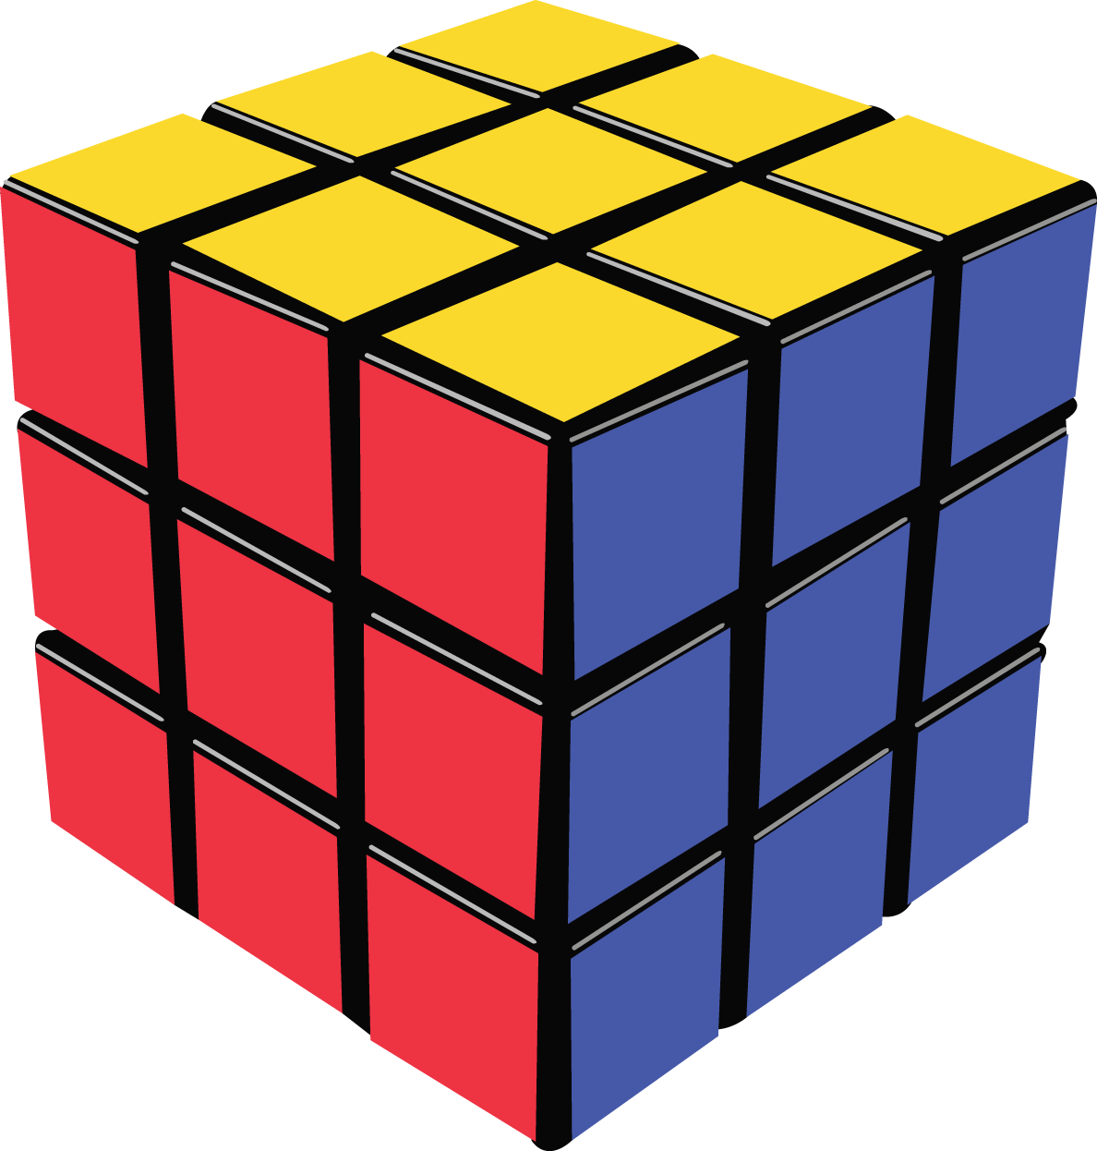
Rubik’s Cube
Puzzle invented by Ernő Rubik
Became a popular toy
Cube of which each face has n x n grid of squares
Each square contains a color
Can be transformed through series of rotations

Slide 3
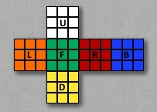

Representation
npm JavaScript library
3D identity matrix where each space is a square
and each digit is a color
Moves are represented by letters denoting
the location and direction of a rotation
1 0 0
0 0
0 0 1
1 0 0
0 0
0 0 1
1 0 0
0 0
0 0 1
1 0 0
0 0
0 0 1
1 0 0
0 0
0 0 1
1 0 0
0 0
0 0 1

Slide 4

Genetic Algorithm
Genes are moves or reorientations
Chromosomes are permutations or strings of moves
Individuals are Cubes with potential solutions enacted on them
Populations varied (500 or 1000)
Elite percentage varied (10 or 30)

Slide 5
Genetic Algorithm (cont.)
Reproduction is asexual
Mutation is guaranteed, but is always different
If solution not found in 50 generations, reset
Fitness function uses “sticker counting”, comparing
each square on a population member to the Identity Cube

Slide 6

Wisdom of Artificial Crowds
Cannot be aggregated in a similar way to TSP
Many iterations of GA ran at once
The fastest lineage to return a solution is the one chosen
Could be improved by comparing number of moves

Slide 7
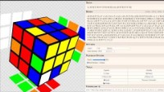
Demo

Slide 8
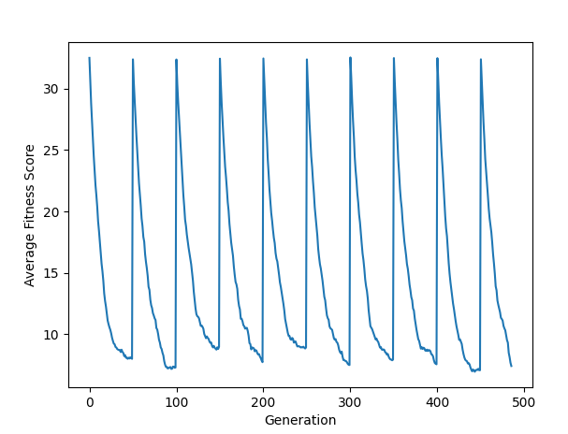
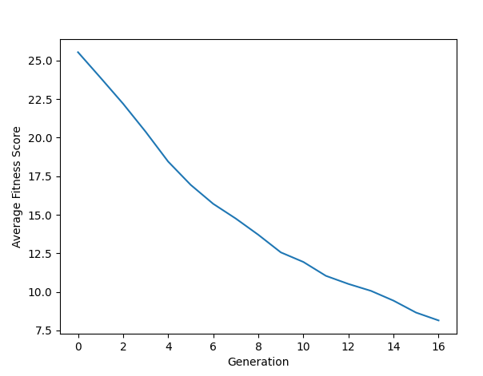
Results
Greatest Time Taken
Least Time Taken

Slide 9

Results (cont.)
GA Final Table

Slide 10
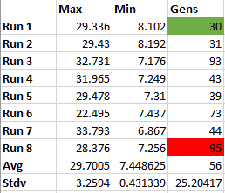
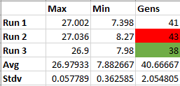
Results (cont.)
Best GA Returns
WOC Returns

Slide 11
Final Thoughts and Questions

Slide 12
References
“Alg.cubing.net,” alg.cubing.net. [Online]. Available: https://alg.cubing.net/. [Accessed: 15-Nov-2021].
Association for the Advancement of Artificial Intelligence. [Online]. Available: https://www.aaai.org/. [Accessed: 20-Nov-2021].
“God's algorithm,” Wikipedia, 13-Oct-2021. [Online]. Available: https://en.wikipedia.org/wiki/God%27s_algorithm. [Accessed: 20-Nov-2021].
“God's number is 20,” God's Number is 20. [Online]. Available: https://www.cube20.org/. [Accessed: 15-Nov-2021].
“God's number is 26 in the quarter-turn metric,” God's Number is 26 in the Quarter Turn Metric. [Online]. Available: https://www.cube20.org/qtm/. [Accessed: 20-Nov-2021].
“Main page,” SpeedSolving the Rubik's Cube - Speedsolving.com Wiki. [Online]. Available: https://www.speedsolving.com/wiki/index.php/Main_Page. [Accessed: 15-Nov-2021].
“Online rubik's cube solver,” Rubik's Cube Solver. [Online]. Available: https://rubiks-cube-solver.com/. [Accessed: 15-Nov-2021].
R. V. Yampolskiy, Artificial Superintelligence: A futuristic approach. BOCA RATON: CHAPMAN & HALL CRC, 2016.
R. V. Yampolskiy, “CSE 545: Artificial Intelligence,” in University of Louisville - J.B. Speed School of Engineering: Computer Science Engineering.
R. V. Yampolskiy, L. Ashby, and L. Hassan, “Wisdom of artificial crowds a metaheuristic algorithm for ...” [Online]. Available: http://cecs.louisville.edu/ry/Wisdom.pdf. [Accessed: 20-Nov-2021].
R. V. Yampolskiy, “Taxonomy of Pathways to Dangerous Artificial Intelligence,” AAAI. [Online]. Available: https://www.aaai.org/ocs/index.php/WS/AAAIW16/paper/view/12566/12356. [Accessed: 20-Nov-2021].
R. Vaccari, “Solving Rubik's Cube using genetic algorithms,” Roberto Vaccari, 07-Jul-2020. [Online]. Available: https://robertovaccari.com/blog/2020_07_07_genetic_rubik/. [Accessed: 15-Nov-2021].
“Rubik's Cube,” Wikipedia, 14-Oct-2021. [Online]. Available: https://en.wikipedia.org/wiki/Rubik%27s_Cube. [Accessed: 15-Nov-2021].
“Rubiks-cube,” npm. [Online]. Available: https://www.npmjs.com/package/rubiks-cube. [Accessed: 15-Nov-2021].
S. Chinthala, A. Fox, and A. Spalding, “To Flip or Not to Flip: Pancake Sorting with Genetic Algorithms and Wisdom of Crowds.” [Online]. Available: http://www.aaronfox.me/pdfs/Pancake_Sorting.pdf.
S. J. Russell, P. Norvig, and M.-W. Chang, Artificial Intelligence: A modern approach. Harlow: Pearson, 2022.
Thewca, “Thewca/tnoodle: Development for the official WCA Scramble Server,” GitHub. [Online]. Available: https://github.com/thewca/tnoodle. [Accessed: 15-Nov-2021].
“Visualization with python,” Matplotlib. [Online]. Available: https://matplotlib.org/. [Accessed: 20-Nov-2021].
“Welcome to the World Cube Association,” World Cube Association. [Online]. Available: https://www.worldcubeassociation.org/. [Accessed: 15-Nov-2021].
Yampolskiy, Roman & El-Barkouky, Ahmed. (2011). Wisdom of artificial crowds algorithm for solving NP-hard problems. IJBIC. 3. 358-369. 10.1504/IJBIC.2011.043624.

